Slide 1
SAP Challenge 21.11.2021
Caspar Kwong, Yung Yu Hsu

Slide 2
Data Analysis -
Turkish Retail Data

Slide 3
Tools used in analysis
R
Packages:
ggplot2
dplyr
tidyr
tsibble
lubridate
fpp2
fpp3
Python
Packages:
Pandas
NumPy
SciPy
Matplotlib
Seaborn

Slide 4
Data Processing
Tidy up data and remove unusable entries
Aggregate daily data into monthly data
Group and summarize data base on products types, stores locations and size
Forecasting based on collected time series
Visualizations for exploration

Slide 5
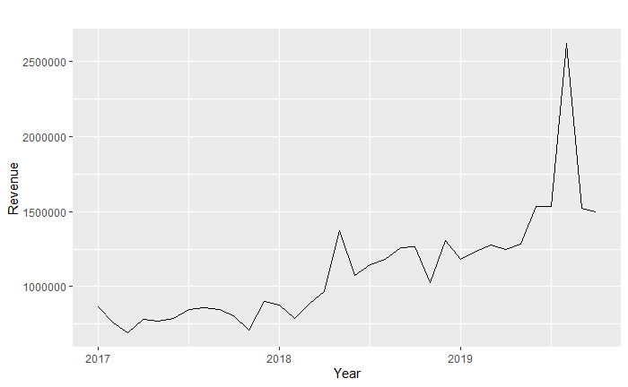
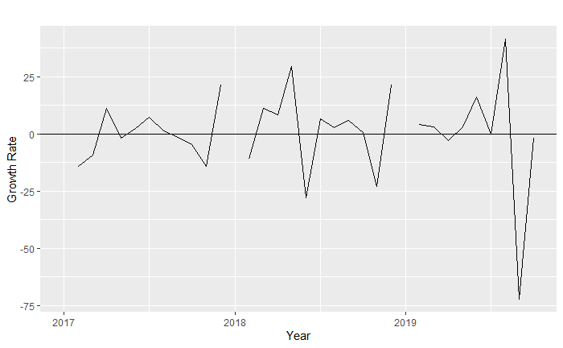
Trends- Overall
Monthly Aggregated Revenue
Rising revenue over the
past 3 years
Increasing growth rate

Slide 6
Outlier
Revenue doubled that of average in August 2019

Slide 7
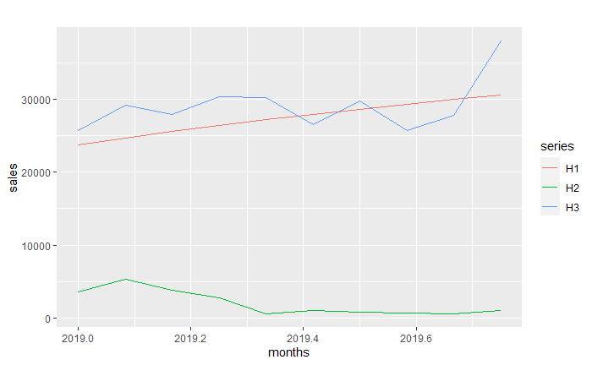
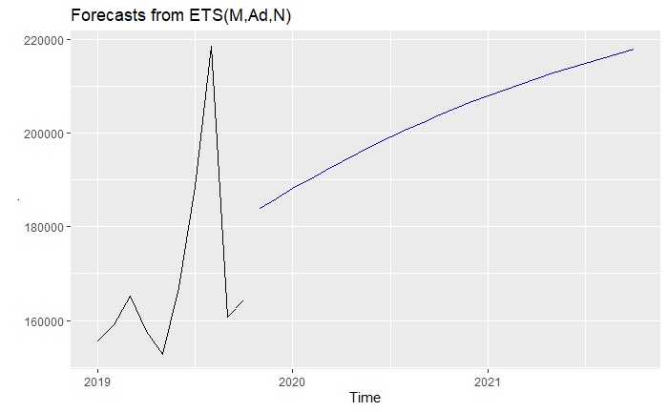
Sales Forecast
H0-H3 type products are expected to see an increase in sales while H3 products will suffer from a drop

Slide 8
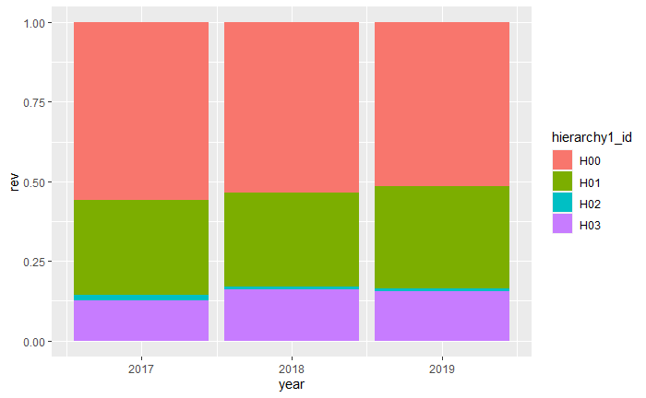
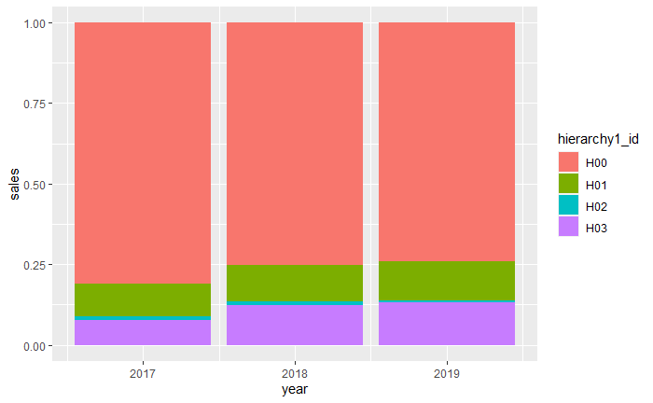
Percentage of Sales and Revenue for Different Product Types
Although type 0 product has the highest sales volume and revenue, type 1 product seems to be more important in revenue relative to its sales

Slide 9
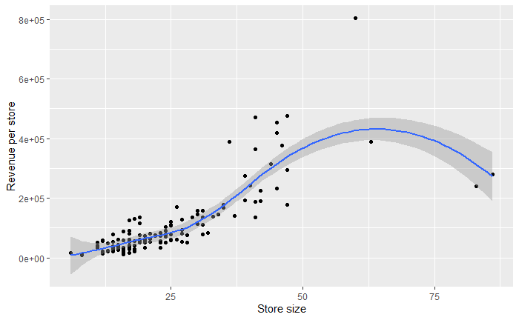
Store Performance against Size
Stores with size between 32 to 50 sqm outperform other stores

Slide 10
Our idea & demonstration -
A website for sales report

Slide 11
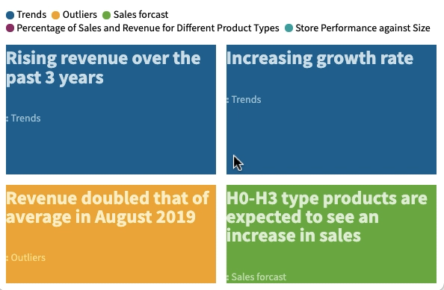
Latest news
Revenue & Sales doubled that of average in August 2019

Slide 12
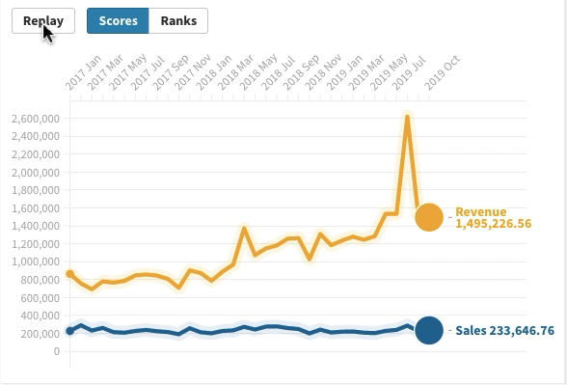
Let’s view the monthly revenue and sales trend

Slide 13
Is it an error ?
Anything to do with the promotion or discount ?
Need more investigation!

Slide 14
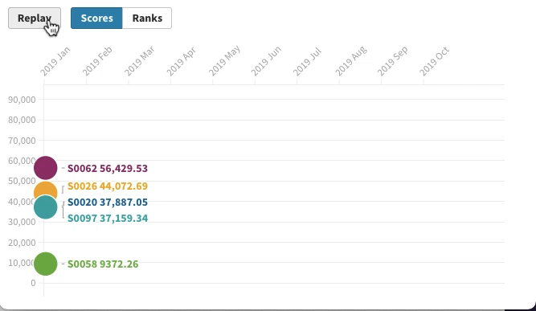
Top 5 stores in City 14 have the peak

Slide 15
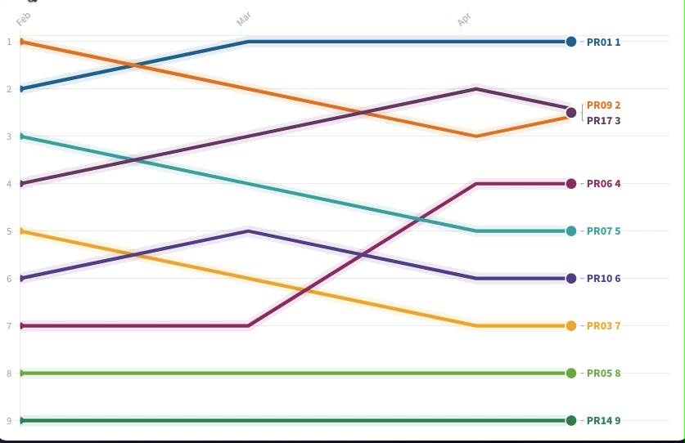
No special promotion change

Slide 16
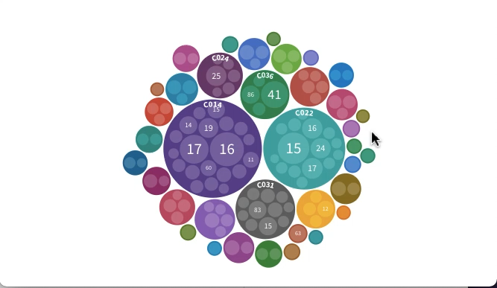
Map -> Cities
City 3
City 4
City 1
City 2
City 5

Slide 17
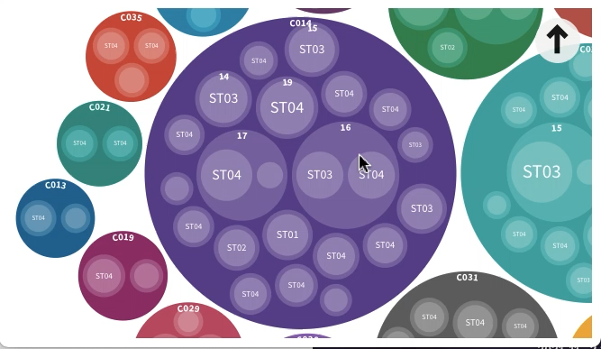
City -> Stores
Properties
Store
store
store
store
store
store
store

Slide 18
Drag the smiley face -> Visit the store
Store
store
store
store
store
Store S0007
store
store

Slide 19
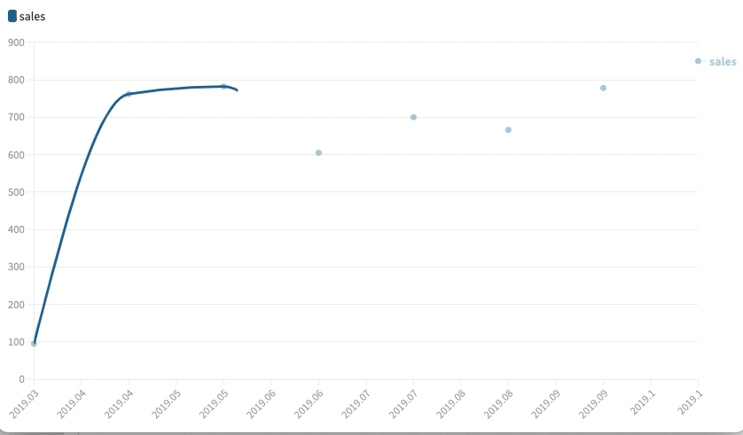
Virtual Assistant
What would you like to know?
Show me the sales of S0007
Congratulations! The new store S0007 opened in March 2019, has a steady growth in sales.
send

Slide 20
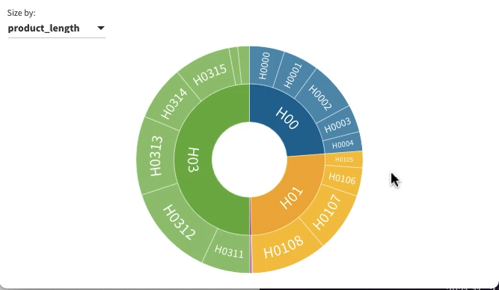
Detailed charts/hierarchy of products & stores

Slide 21
!Our website!
big headline on the main website to immediately catch the attention of the important findings
animated chart to view the trends and other related parameters
other features such as viewing the hierarchy of the products and stores

Slide 22
Thank you !

